Slide 1
QUALITY OF SERVICE & DNS -by Hitesh Nautiyal

Slide 2
Quality of Service(QoS) :-
Quality of Service (QoS) is a group of technologies that operate on a network to ensure that high-priority traffic and applications may be reliably carried out even when the network's capacity is constrained.
the QoS specifies that supporting priority for one or more flows will not fail other flows. A flow can consist of a packet from a particular application or an incoming interface as well as source and destination addresses, source and destination socket numbers, session identifiers, and packets.
The companies can avoid interruptions in real-time communications applications such as VoIP (voice over IP), AoIP (audio over IP), and others by using quality of service (QoS).

Slide 3
Techniques used in QoS :-
Scheduling :
Packets from one-of-a-kind flows arrive at a transfer or router for processing. An exact scheduling approach treats the one-of-a-kind flows truthfully and suitably. Several scheduling strategies are designed to enhance the exceptional of the provider.
Three of them here-
FIFO Queuing Packets wait in a buffer (queue) in first-in, first-out (FIFO) queuing until the node (router or switch) is prepared to process them. The queue will get full and new packets will be deleted if the average arrival rate exceeds the average processing rate. Anyone who has had to wait at a bus stop for a bus knows what a FIFO queue is like.
Priority Queuing Packets are first given a priority class in priority queuing. Each type of priority has its own queue. The first packets processed are those in the queue with the highest priority. The final packets processed are those in the lowest priority queue. The system continues to serve a queue until it is empty, it should be noted.
Weighted Fair Queuing The packets are still allowed to various queues and assigned to various classes in this method. The queues are, however, weighted according to their priority; a higher priority corresponds to a higher weight. The quantity of packets processed from each queue is determined by the associated weight, and the system processes packets in each queue in a round-robin method.
Three packets are processed from the first queue, two from the second queue, and one from the third queue, for instance, if the weights are 3, 2, and 1. All weights can be equal if the system does not give the classes any sort of priority.

Slide 4
Traffic Shaping :
Traffic shaping is a mechanism to manipulate the quantity and the price of the visitors dispatched to the network. Two strategies can form visitors: Leaky Bucket and Token Bucket.
Leaky Bucket:
The leaky bucket algorithm is a technique for creating a set-rate output of packets by grouping a variable number of requests into temporary storage.
This fundamental idea is used in the Leaky Bucket Algorithm, which is nothing more than a single server queuing system with constant service time.
Think of a bucket that has a hole in the bottom. No matter how quickly water enters the bucket, it always seeps out through the hole at the same rate. If there is no water in the bucket, the rate of flow is zero; if the bucket is full, any extra water pours out and is lost.
Token Bucket
It is possible to design a conventional token bucket shaper as a counter that increments at a rate corresponding to the desired shaping bandwidth. The next packet in the queue is transmitted, and the counter is decremented by the size of the packet when the counter reaches a value equal to its size in bytes. In this manner, a particular queue's sent bytes per second will be proportionate to the counter rate.
To reduce downstream congestion, this kind of traffic shaping is frequently utilized in the outgoing switch ports of systems.

Slide 5
Domain Name System :-
It is an application layer protocol.
Purpose-
DNS is a host name to IP Address translation service.
It converts the names we type in our web browser address bar to the IP Address of web servers hosting those sites.
Need-
The need for Domain Name Service arises due to the following reasons-
Point-01:
IP Addresses are not static and may change dynamically.
So, a mapping is required which maps the domain names to the IP Addresses of their web servers.
Point-02:
IP Addresses are a complex series of numbers.
So, it is difficult to remember IP Addresses directly while it is easy to remember names.

Slide 6
DNS Resolution-
DNS Resolution is a process of resolving a domain name onto an IP Address.
The steps involved in DNS Resolution are-
Step-01:
A user program sends a name query to a library procedure called the resolver.
Step-02:
Resolver looks up the local domain name cache for a match.
If a match is found, it sends the corresponding IP Address back.
If no match is found, it sends a query to the local DNS server.
Step-03:
DNS server looks up the name.
If a match is found, it returns the corresponding IP Address to the resolver.
If no match is found, the local DNS server sends a query to a higher level DNS server.
This process is continued until a result is returned.
Step-04:
After receiving a response, the DNS client returns the resolution result to the application.

Slide 7
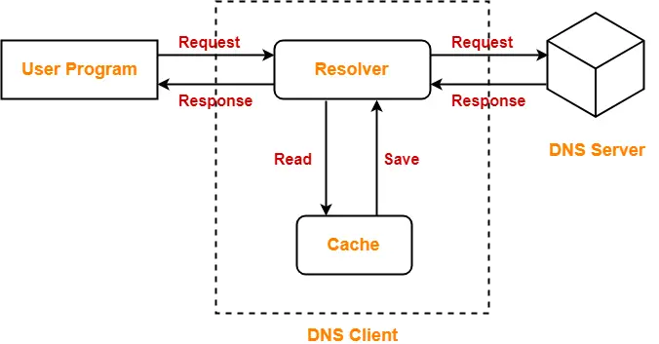
DNS Resolution Diagram :-

